Slide 1

FINAL REPORT
SUBJECT: DECISION SUPPORT SYSTEMS
Student:
Le Tuan Khanh
MSSV: 19521681
Tran Nhat Tan
MSSV: 19522177
Lecturer: Mr. Nguyen Thanh Binh
Mr. Nguyen Ho Duy Tri

Slide 2
TOPIC:
PREDICTS THE LIKELIHOOD OF HEART DISEASE IN HUMANS

Slide 3
REASON OF PROJECT

Slide 4
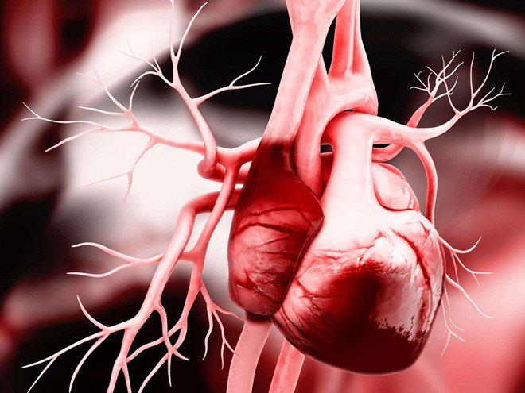

REASON OF PROJECT
Currently, cardiovascular disease is gradually becoming a burden on society, leading to many consequences in life.
According to WHO - World Health Organization, every year about 17.5 million people die from diseases of the heart and blood vessels.
Every 2 seconds someone will die from cardiovascular disease, every 5 seconds someone will have a heart attack.

Slide 5

REASON OF PROJECT
Therefore, analyzing data to make the right decisions for human health is extremely necessary to quickly find solutions that contribute to improving the health of the whole society.
The WHO report also said that the rate of cardiovascular disease is increasing in developing countries, including Vietnam.
In addition, the cost of cardiovascular disease examination and treatment is also an economic burden costing hundreds of billions of dollars per year.
Picture: A woman with heart attach

Slide 6

CONTENT

Slide 7


01
02
03
04
CONTENT
TOPIC OVERVIEW
Deployment
Conclusion
BUILD AN APPLICATION AND DEMO

Slide 8
01
TOPIC OVERVIEW
Topic content
Description of original data

Slide 9
3.235
12
Rows
Topic content
Data sources Heart Disease Dataset | Kaggle
Link: https://www.kaggle.com/datasets/johnsmith88/heart-disease-dataset
Columns
From1988
to present

Slide 10
3.235
12
Rows
Columns
From1988
to present
Topic content
Data sources Heart Disease Dataset | Kaggle
Link: https://www.kaggle.com/datasets/johnsmith88/heart-disease-dataset
This is the Heart Disease Risk Classification Dataset shared on https://www.kaggle.com/ . This dataset dates back to 1988 and includes four databases: Cleveland, Hungary, Switzerland, and Long Beach V. It contains 76 attributes, including the predictor attribute, but all the tests have been exported. versions all use a subset of 12 of them. The field "Target" refers to the presence of heart disease in the patient. It is an integer with values ​​0 = no disease and 1 = disease

Slide 11
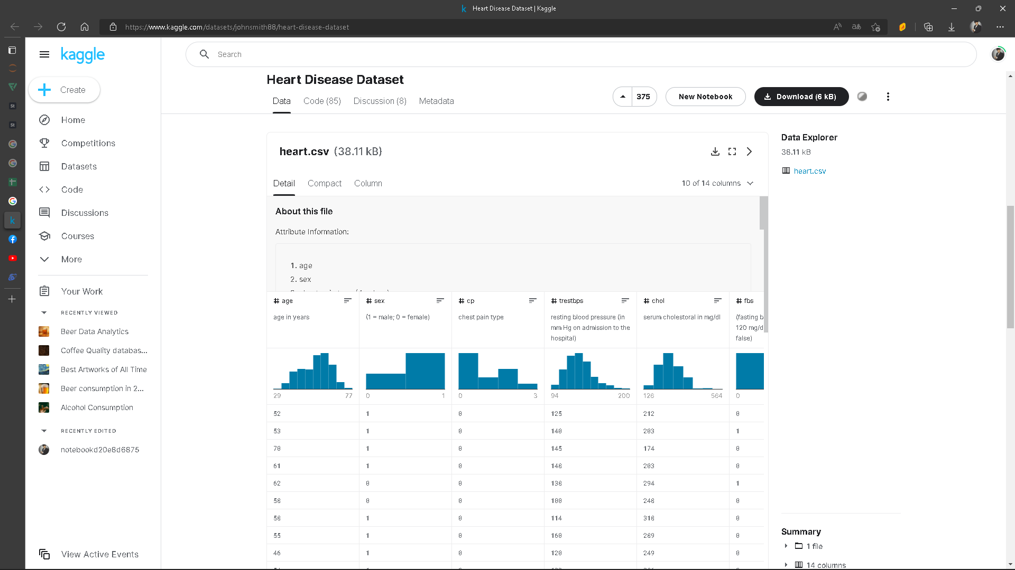
2. Description of original data

Slide 12
2. Description of original data
STT | Attribute | Data type | Description
1 | age | number | age
2 | sex | binary | gender
3 | cp | number | Chest pain type
4 | trestbps | number | blood pressure at rest (in mm Hg on admission)
5 | chol | number | serum cholesterol in mg/dl
6 | fbs | number | (fasting blood sugar &gt; 120 mg/dl) (1 = true; 0 = false)
7 | restecg | number | ECG results at rest
8 | thalach | number | Maximum heart rate reached
9 | exang | binary | exercise-induced angina (1 = yes; 0 = no)
10 | oldpeak | number | ST depression induced by exercise relative to rest
11 | slope | number | the slope of the peak exercise ST segment
12 | target | binary | have a heart disease ? (1 = yes; 0 = no)

Slide 13
2. Description of original data
Attribute | Attribute value
age | interger
sex | 0: male 1: female
cp | 0: type chest paint 1 1: type chest paint 2 2: type chest paint 3 3: type chest paint 4
trestbps | interger
chol | interger
fbs | 1: fasting blood sugar & gt; 120mg/dl 0: not fasting…
restecg | 0: no result 1: have result
thalach | interger
exang | float
oldpeak | float
slope | 0: type 1 1: type 2 2: type 3
target | 0: negative with heart disease 1: possitive with heart disease

Slide 14
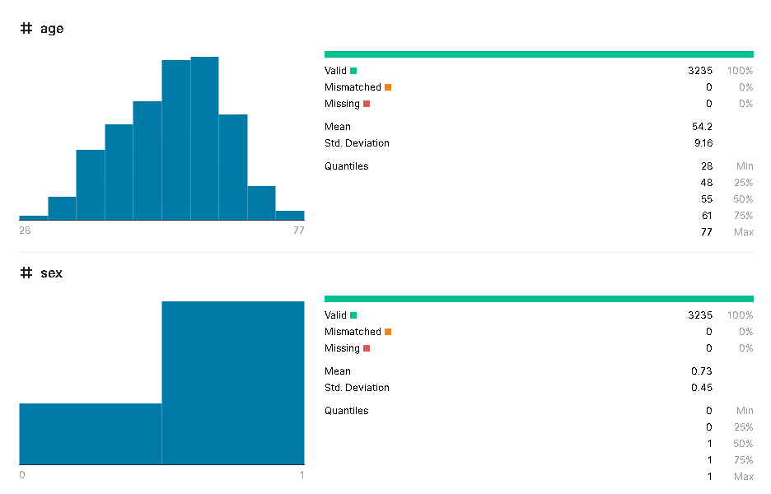
2. Description of original data

Slide 15
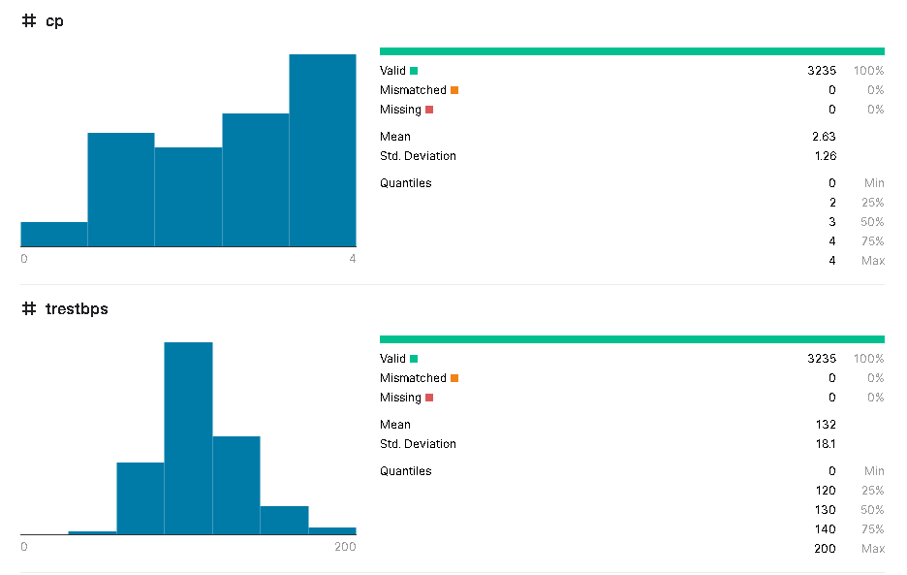
2. Description of original data

Slide 16
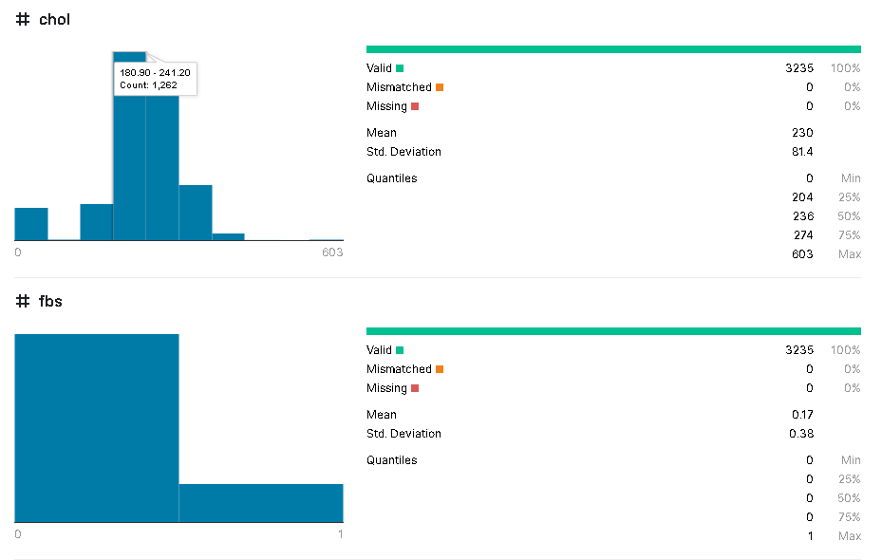
2. Description of original data

Slide 17
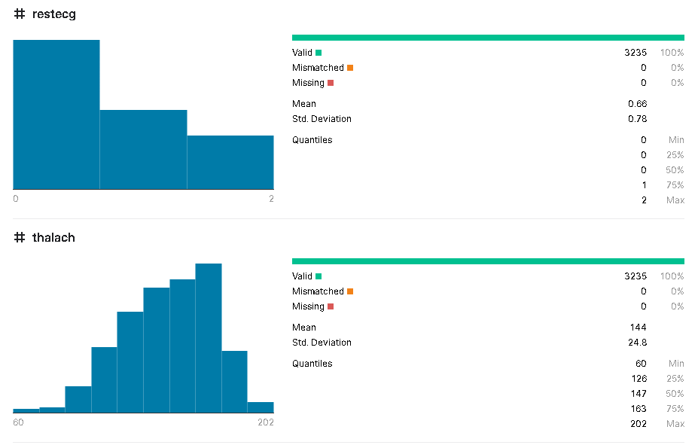
2. Description of original data

Slide 18
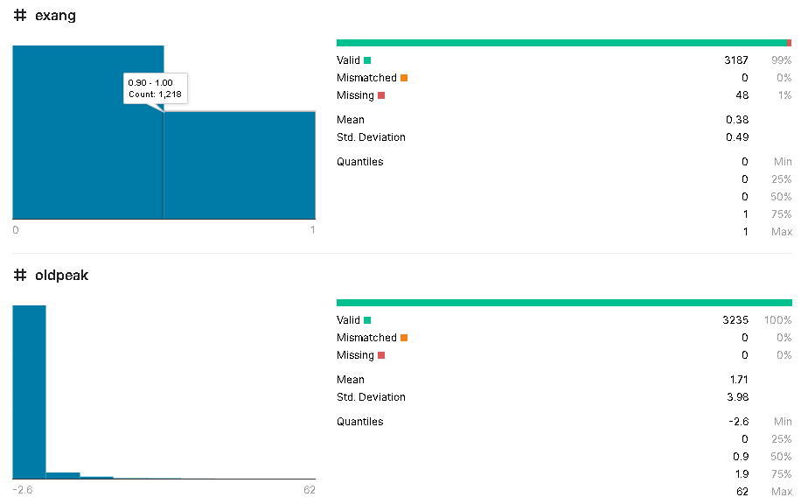
2. Description of original data

Slide 19
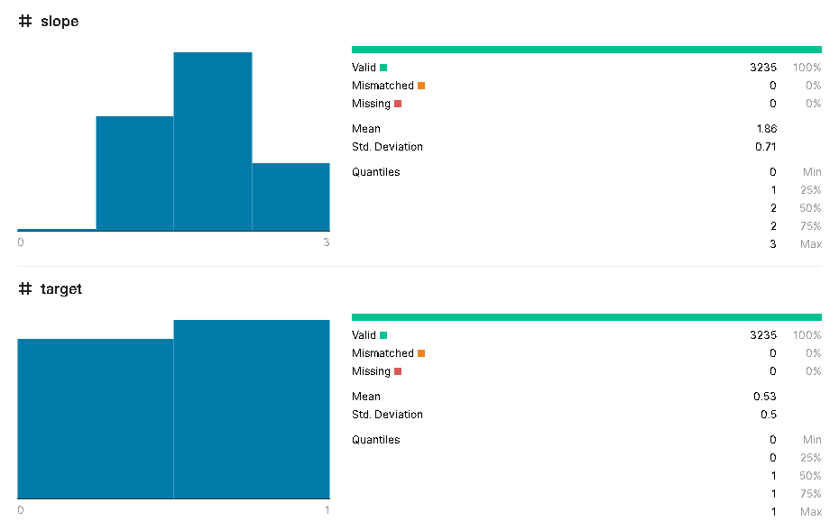
2. Description of original data

Slide 20
01
02
03
04
CONTENT
TOPIC OVERVIEW
Deployment
Conclusion
BUILD AN APPLICATION AND DEMO

Slide 21
02
Deployment
Algorithm used
Data preprocessing
Data distribution
Data classification
Data scaling
Deploy the algorithm

Slide 22
Algorithm used
Decision tree
Decision tree ID3
Random forest
Logistic regression
Knearest

Slide 23
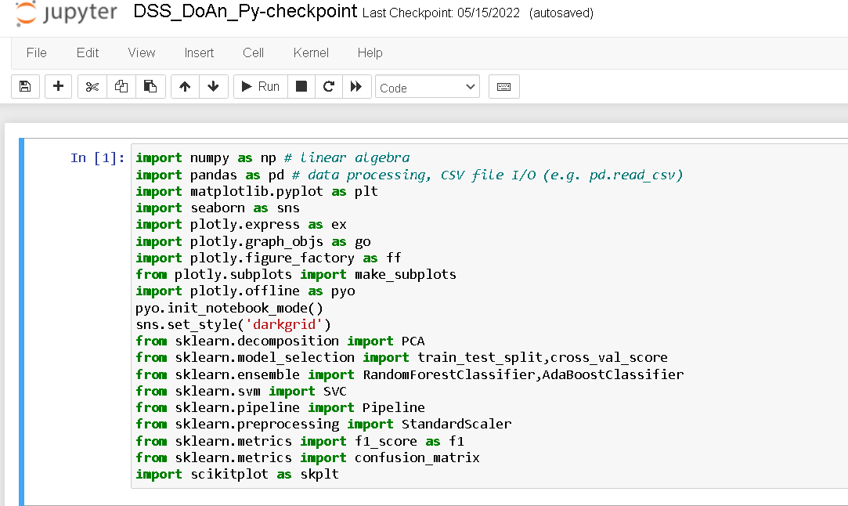
Data preprocessing

Slide 24
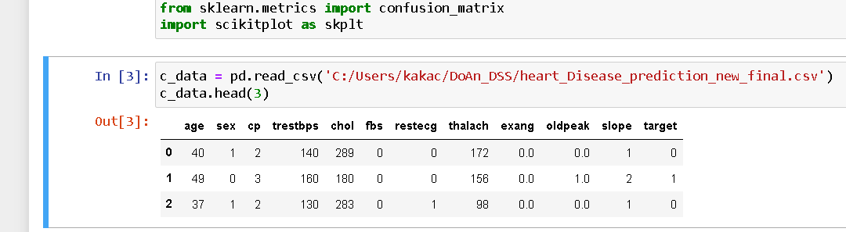
Data preprocessing

Slide 25
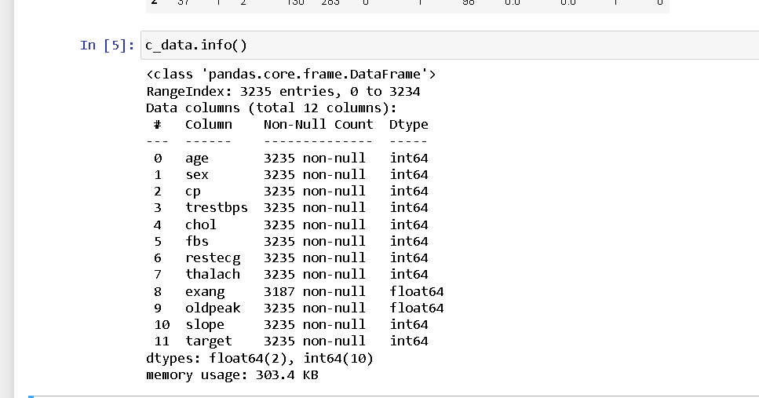
Data preprocessing
original data information

Slide 26
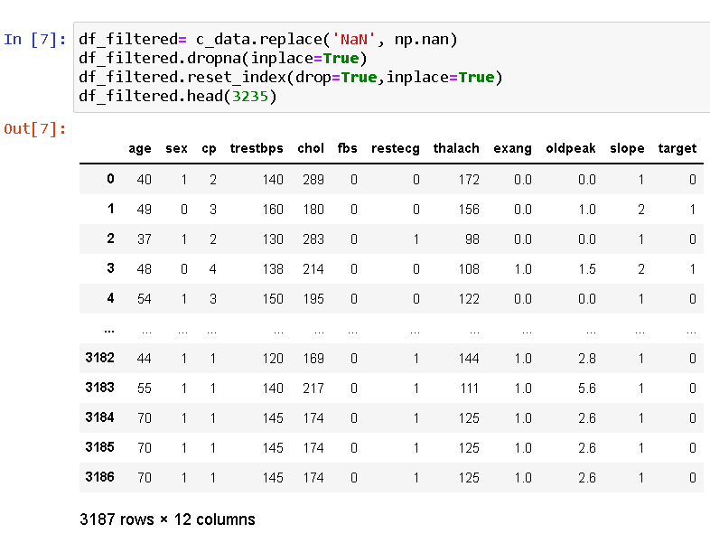
Data preprocessing

Slide 27
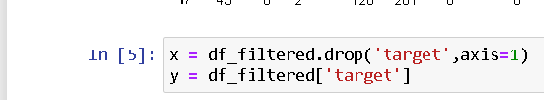
Data preprocessing

Slide 28
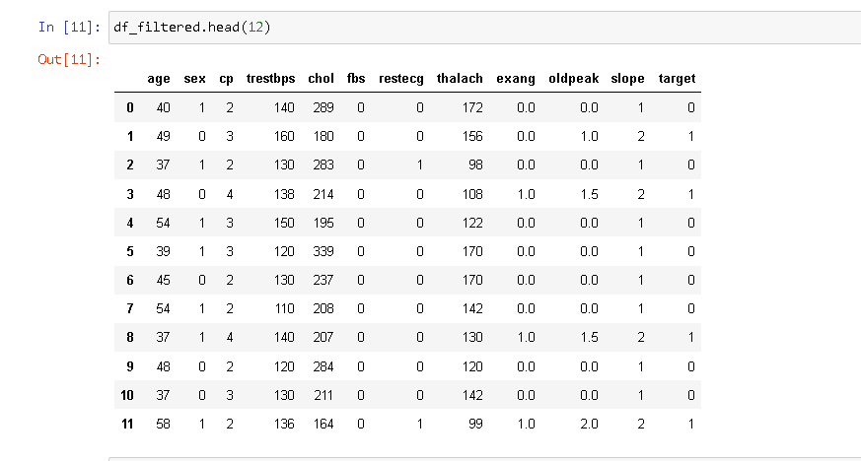
Data preprocessing

Slide 29
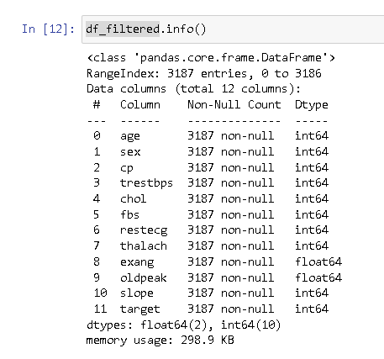
Data preprocessing

Slide 30
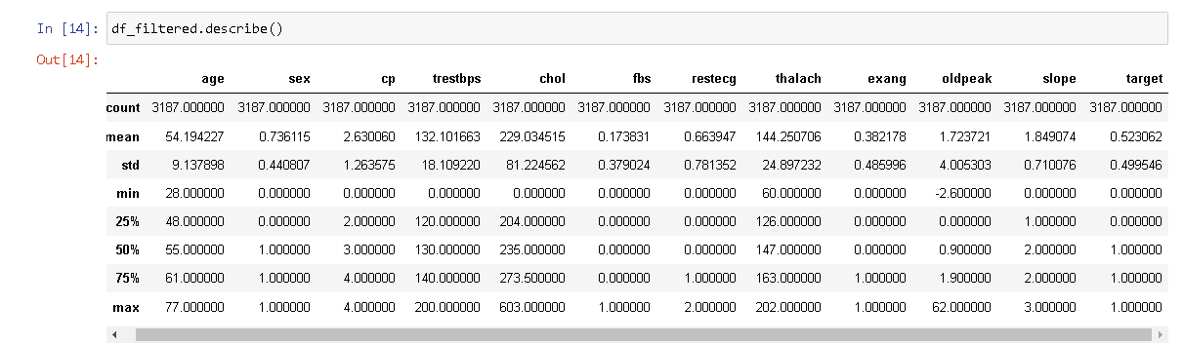
Data preprocessing

Slide 31
Data preprocessing
Data from 3235 lines, after filtering, there are 3187 lines left.
After preprocessing the data, we obtain a data set with all the values ​​of the attributes.
The attributes with data dispersion and scraping continuum are discretized into data intervals.
At this point, the data set is leaner and more accurate, ready for data mining and prediction

Slide 32
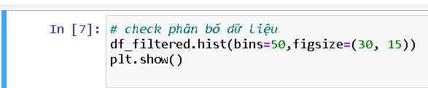
Data distribution

Slide 33
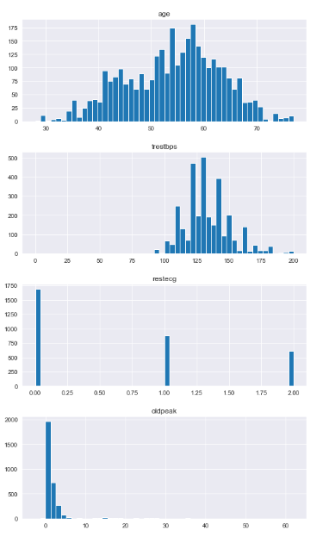
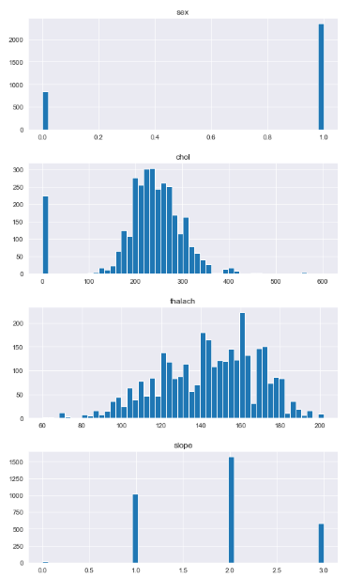
Data distribution

Slide 34
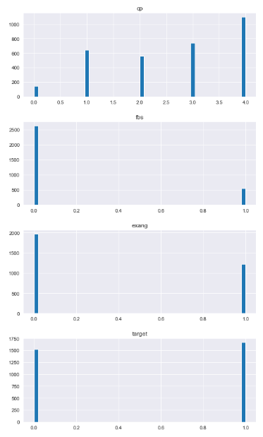
Data distribution

Slide 35
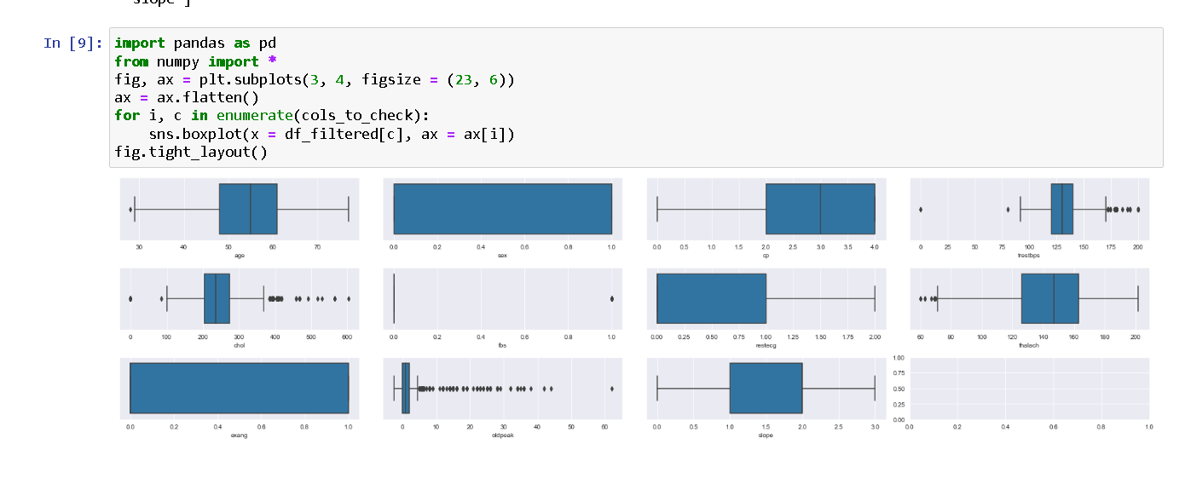
Data distribution

Slide 36
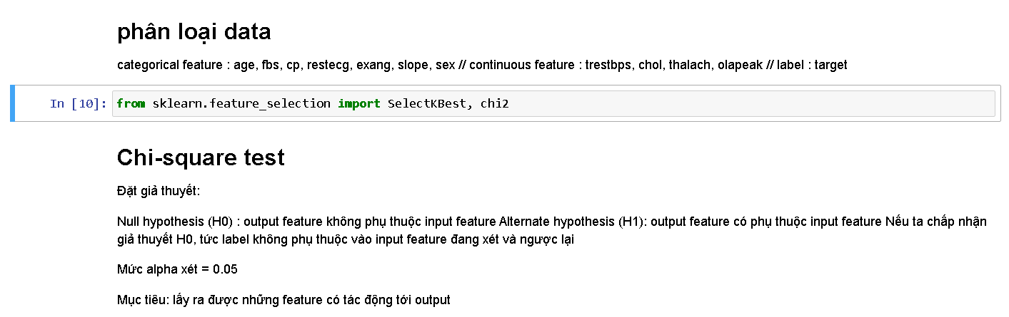
Data classification

Slide 37
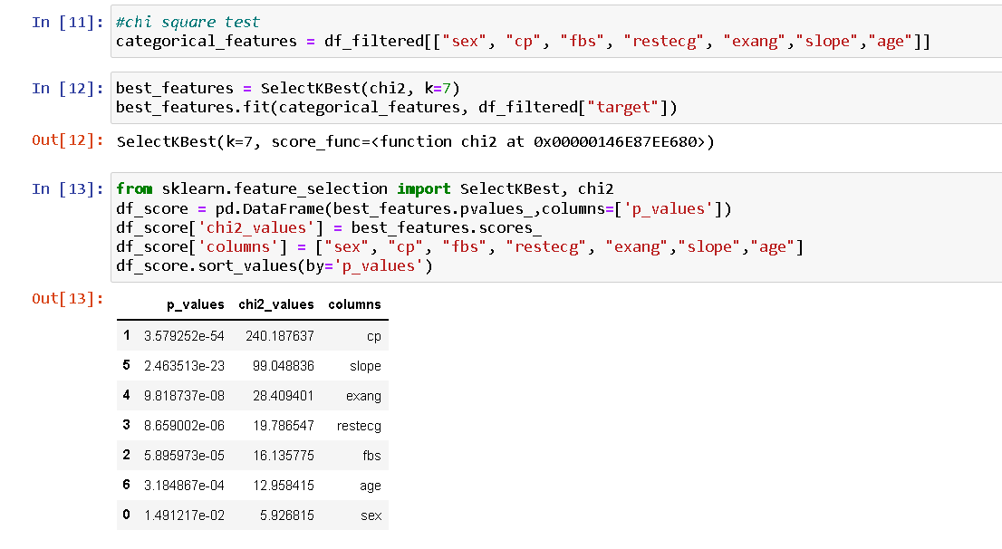
Data classification

Slide 38
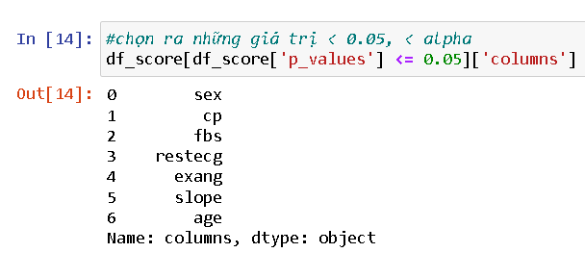
Data classification

Slide 39
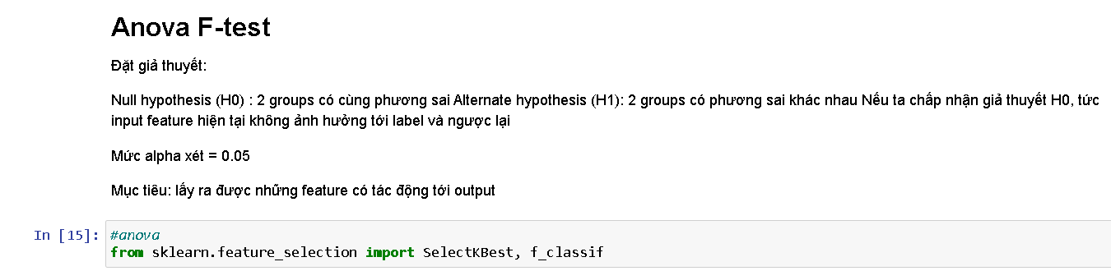
Data classification

Slide 40
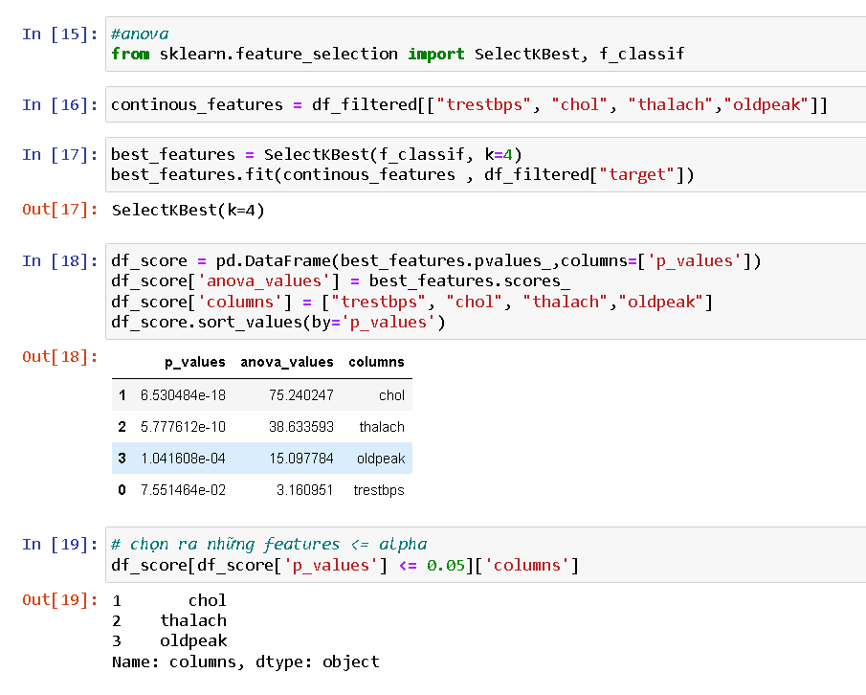
Data classification

Slide 41
Data classification
After Chi-square test and Anova test. We have found the feature that affects the decision attribute, that is: chol, thalach, oldpeak, sex, cp, fbs, retecg, exang, slope, age
select chol, thalach, oldpeak, sex, cp, fbs, retecg, exang, slope, age as input
target as output

Slide 42
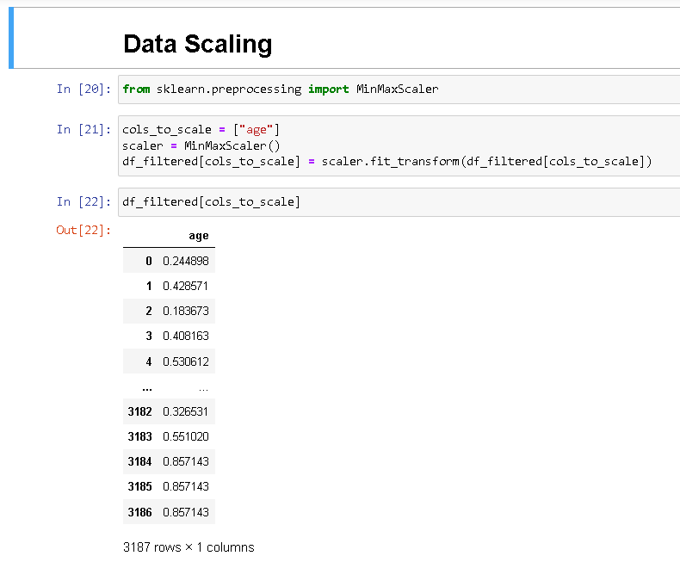
Data scaling

Slide 43
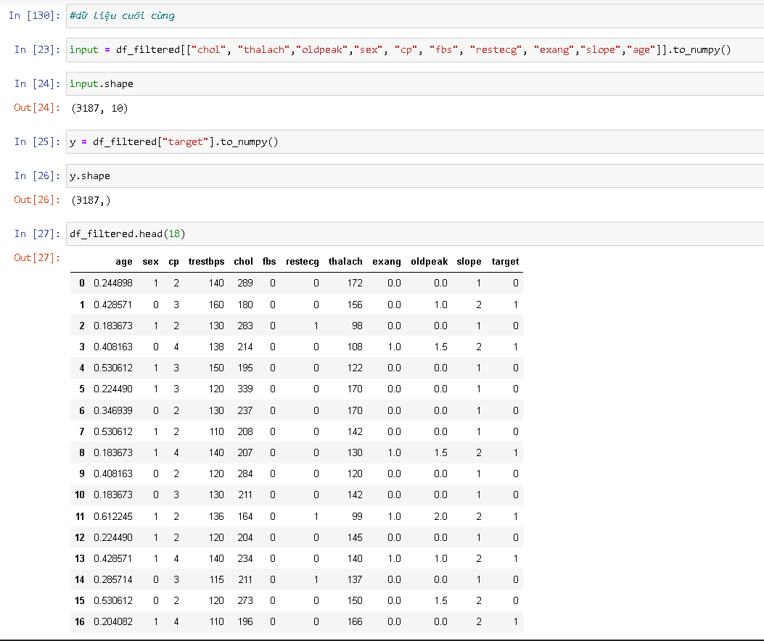
Data scaling

Slide 44
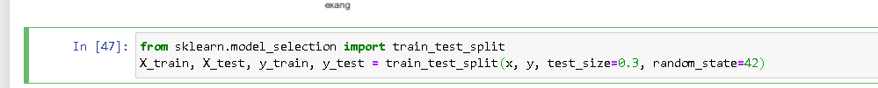
Data scaling
split data into 2 parts: train & test

Slide 45
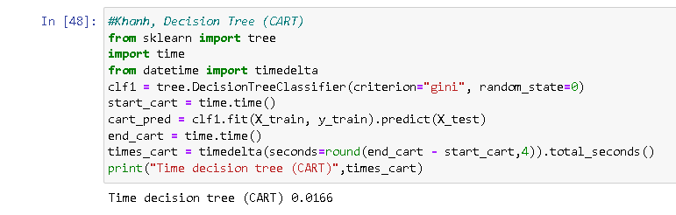
Deploy the algorithm
Decision tree

Slide 46
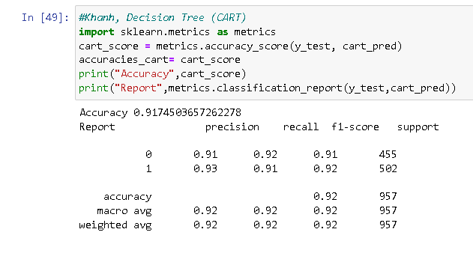
Deploy the algorithm
Decision tree

Slide 47
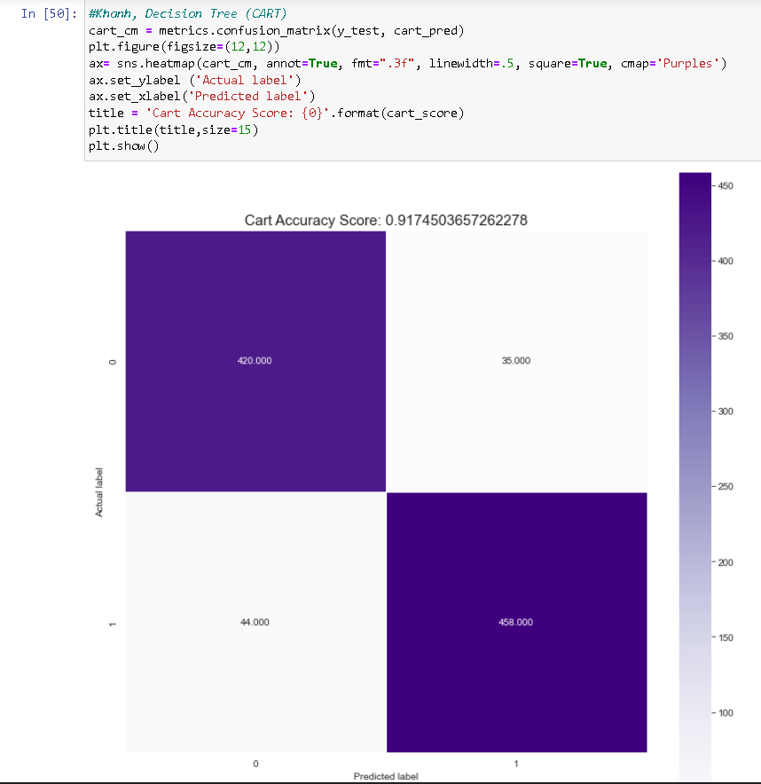
Deploy the algorithm
Decision tree

Slide 48
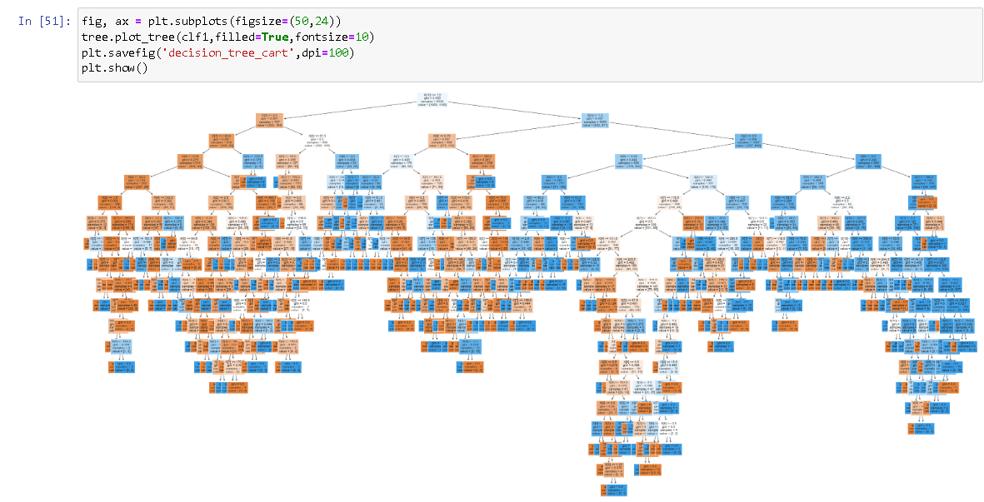
Deploy the algorithm
Decision tree

Slide 49
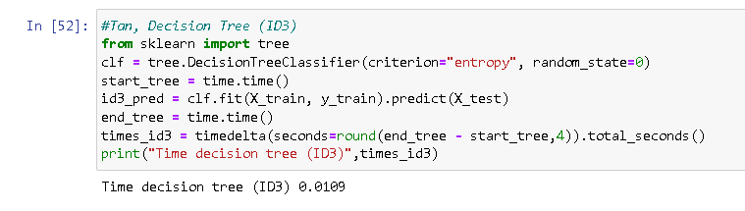
Deploy the algorithm
Decision tree ID3

Slide 50
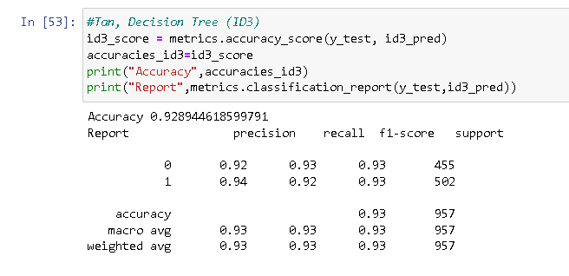
Deploy the algorithm
Decision tree ID3

Slide 51
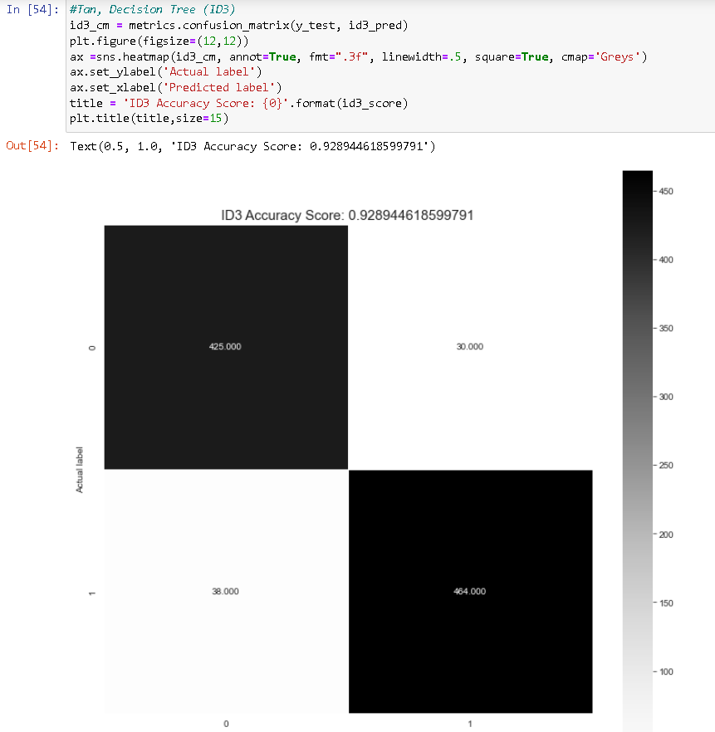
Deploy the algorithm
Decision tree ID3

Slide 52
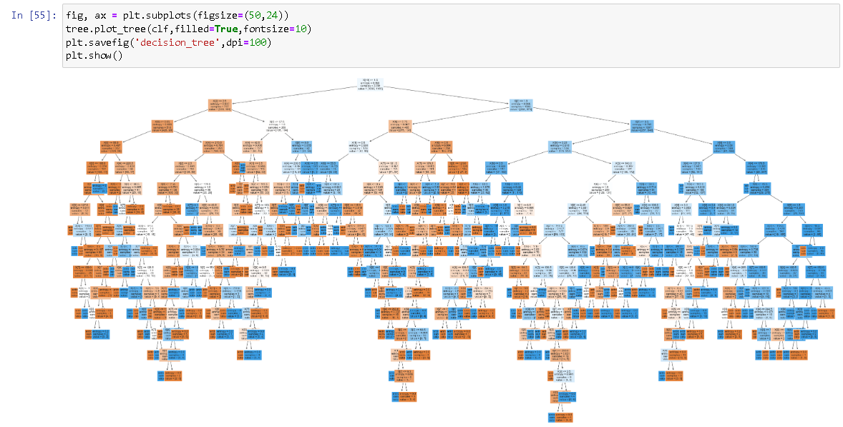
Deploy the algorithm
Decision tree ID3

Slide 53
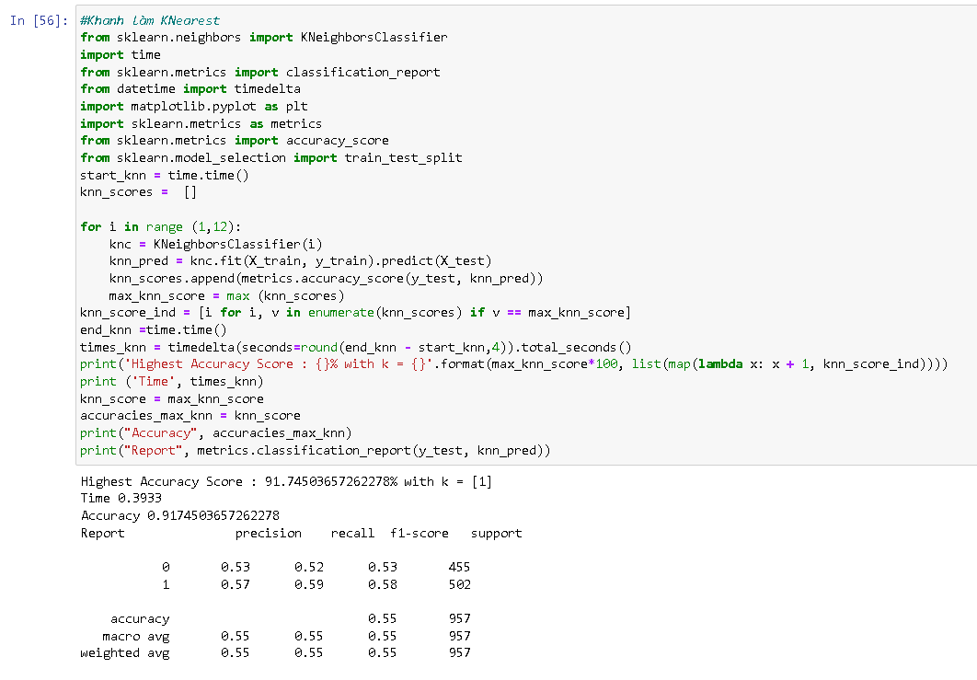
Deploy the algorithm
Knearst

Slide 54
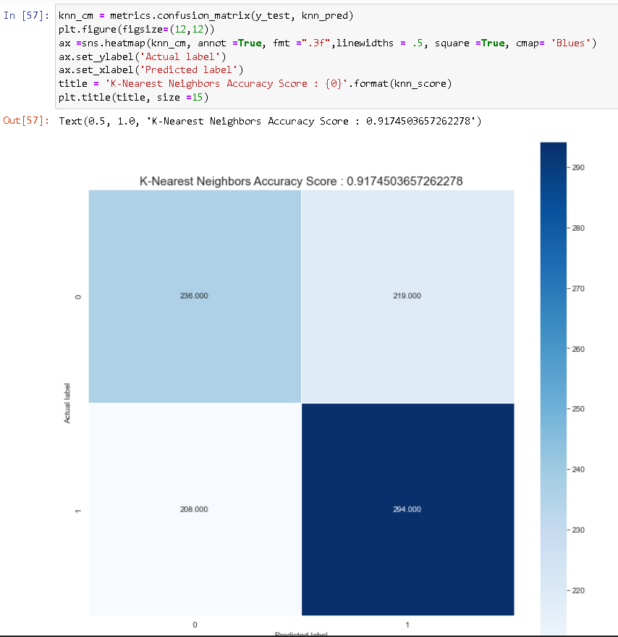
Deploy the algorithm
Knearst

Slide 55
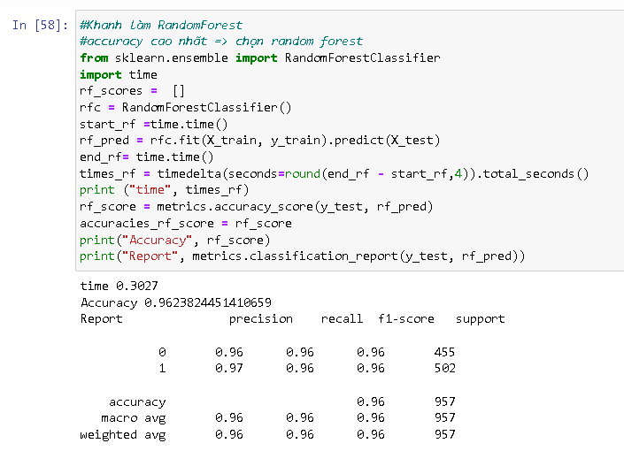
Deploy the algorithm
Random forest

Slide 56
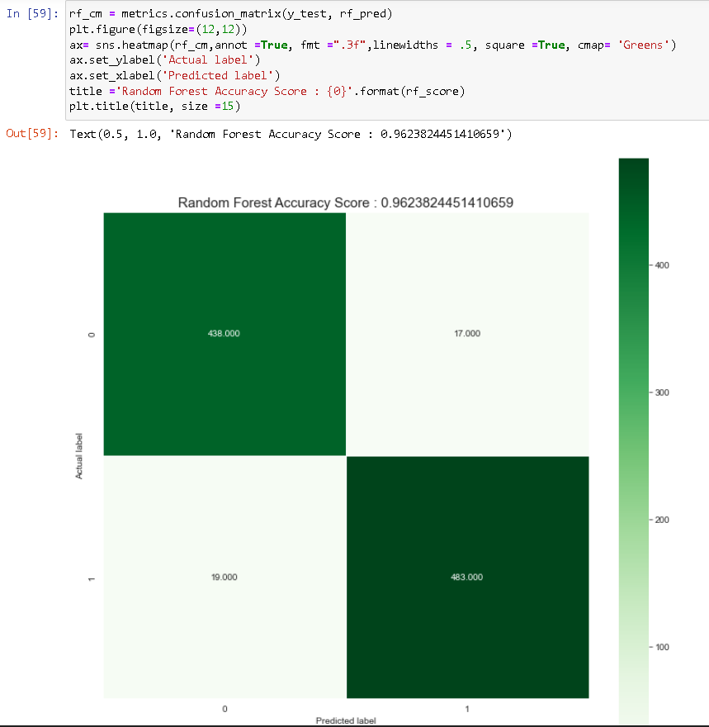
Deploy the algorithm
Random forest

Slide 57
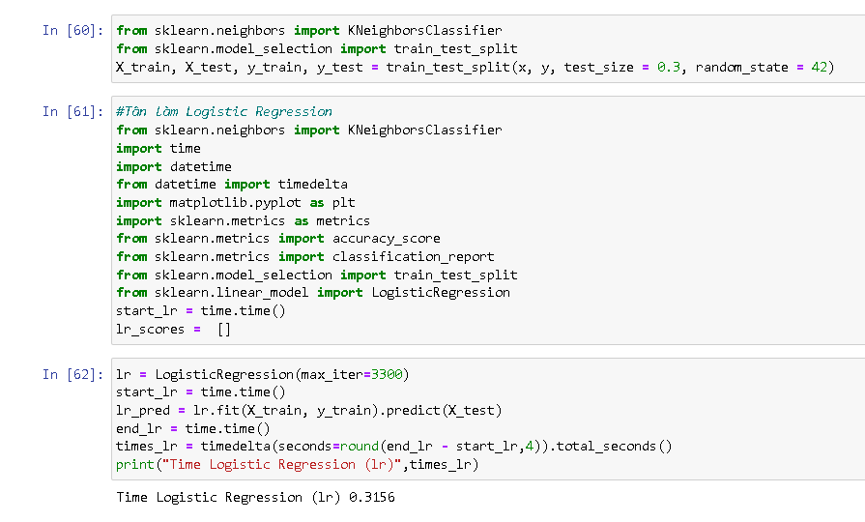
Deploy the algorithm
Logistic regression

Slide 58
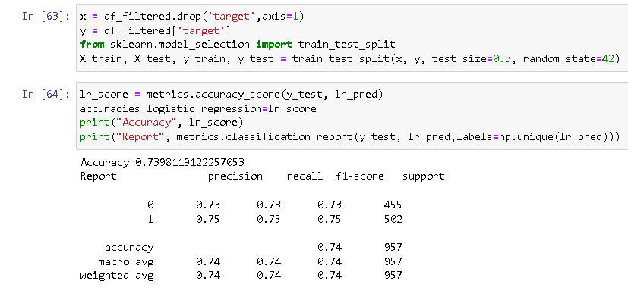
Deploy the algorithm
Logistic regression

Slide 59
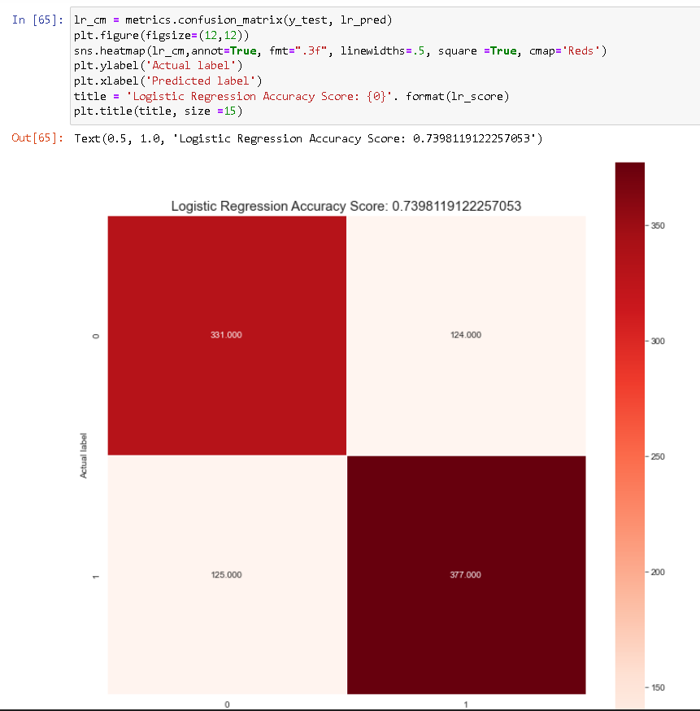
Deploy the algorithm
Logistic regression

Slide 60
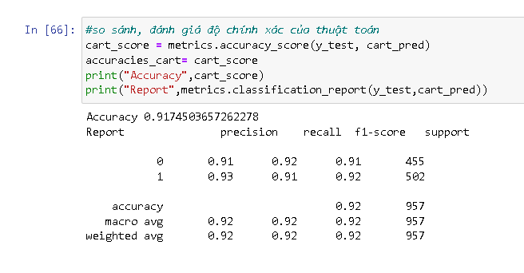
Deploy the algorithm

Slide 61
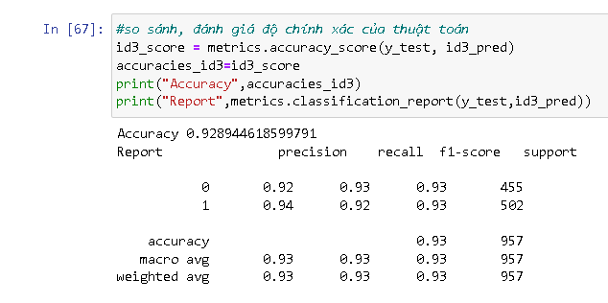
Data classification

Slide 62
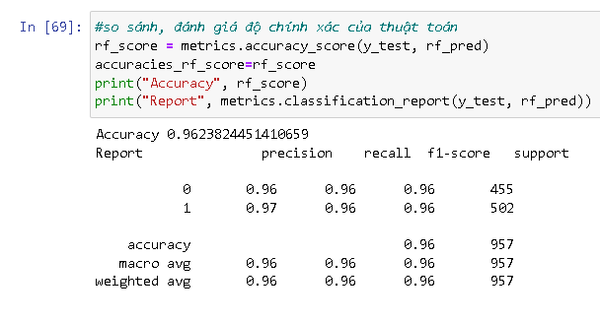
Data classification

Slide 63
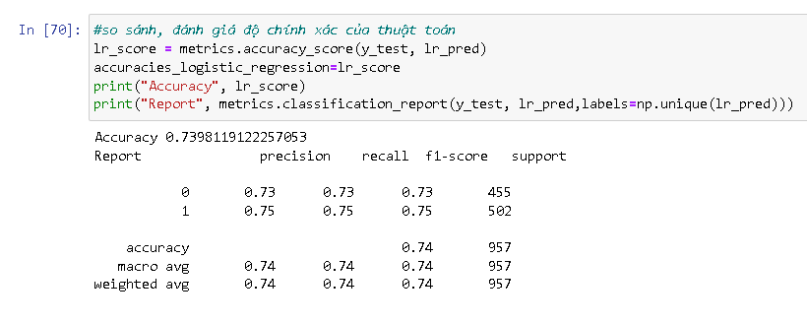
Data classification

Slide 64
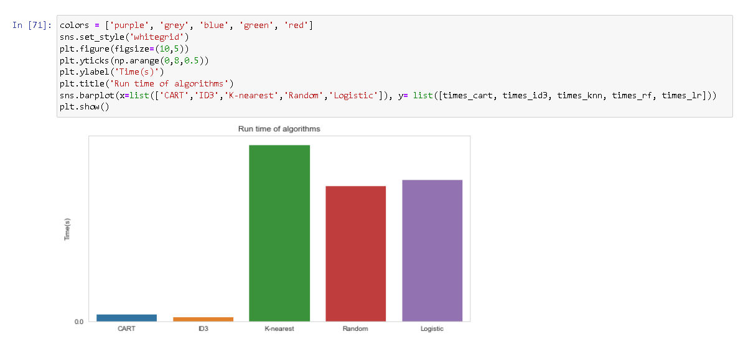
Data classification

Slide 65
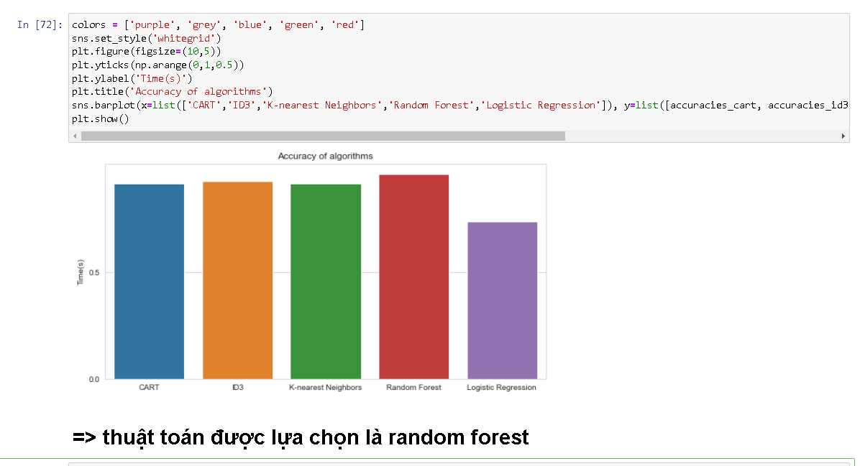
Data classification

Slide 66
Data classification
Looking at the graph as well as the report on the accuracy of the algorithms in turn is Random Forest > ID3 > K-Nearest-Neighbors, Cart > Logistic Regression
If we are interested in the optimal model-wide accuracy, we can choose the Random Forest algorithm to make the best prediction for this dataset with an accuracy of about 96.23%.
If we care about the speed of the model, we can use ID3 or Cart, but overall, the Random Forest algorithm is still the most optimal algorithm.

Slide 67
01
02
03
04
CONTENT
TOPIC OVERVIEW
Deployment
Conclusion
BUILD AN APPLICATION AND DEMO

Slide 68
BUILD AN APPLICATION AND DEMO
03
Algorithm used
Attributes used to make predictions
Interface
Testing
Code of project

Slide 69

Algorithm used
Based on the results obtained in the previous section, the team decided to use the Random Forest algorithm for this software.
According to the comparison results, although this algorithm has a bad speed, it gives the highest accuracy.

Slide 70

Attributes used to make predictions

Slide 71
Attributes used to make predictions
After calculating the confidence of the attributes, we obtain 7 attributes, namely age, cp, trestbps, chol, thalach, oldpeak, and slope to put into the software. These are the 7 attributes with the highest confidence.

Slide 72

Interface

Slide 73

Testing
Data testing:

Slide 74

Testing

Slide 75

Testing

Slide 76

Code of project
Source code upload via: https://github.com/TranNhatTan0312/DoAn_DSS.git

Slide 77
01
02
03
04
CONTENT
TOPIC OVERVIEW
Deployment
Conclusion
BUILD AN APPLICATION AND DEMO

Slide 78
04
Conclusion
Advantage
Disadvantage
Development

Slide 79





SUMMARY
Advantage
Disdvantage
Development direct

Slide 80
TỔNG KẾT
Advantage
1
2
3
Mục đích của môn học
Kỹ năng đạt được
Kinh nghiệm rút ra
Random forest:
Improved with decision tree algorithm, dealing with noise when the data set changes.
Logistic regression:
Good classification when the data is linearly separable.
Easy to deploy and train.

Slide 81
TỔNG KẾT
Advantage
1
2
3
Mục đích của môn học
Kỹ năng đạt được
Kinh nghiệm rút ra
Knearest:
Simple algorithm, easy to implement.
Small computational complexity.
Good handling with noisy data sets.
Decision tree:
Simple, intuitive algorithm, not too complicated to understand at first time.
The training data set is not necessarily too large to build an analytical model.

Slide 82
SUMMARY
Advantage
Disdvantage
Development direct

Slide 83
TỔNG KẾT
Disavantage
1
2
3
Mục đích của môn học
Kỹ năng đạt được
Kinh nghiệm rút ra
Random forest:
is a large amount of computation.
Logistic regression:
Easily affected by noise.
Cannot solve non-linear problems.

Slide 84
TỔNG KẾT
Disavantage
1
2
3
Mục đích của môn học
Kỹ năng đạt được
Kinh nghiệm rút ra
Knearest:
With small K, it is easy to encounter noise, leading to inaccurate results
It takes a long time to perform because it has to calculate the distance to all the objects in the data set.
Need to convert data types to qualitative factors.
Decision tree:
Decision tree algorithm only applies to qualitative variables (classification tree) if wrong classification can lead to serious error.
Decision tree algorithms are likely to be “biased” or biased if the dataset is unbalanced..

Slide 85
SUMMARY
Advantage
Disdvantage
Development direct

Slide 86
TỔNG KẾT
Development derection
1
2
3
Mục đích của môn học
Kỹ năng đạt được
Kinh nghiệm rút ra
Research and learn more about datasets, adjust attributes and preprocessors for better accuracy.
Continue to apply other classification algorithms such as SVM, Artificial Neuron Network, ... to find the optimal algorithm.

Slide 87
SUMMARY
Advantage
Disdvantage
Development direct

Slide 88
THANKS for listening
Do you have any question ?

